Slide 1
Using Satellite Imagery to Detect Urban Markets: An Application to India November 2018 Kathryn Baragwanath-Vogel, UC San Diego Ran Goldblatt, New Light Technologies Gordon Hanson, UC San Diego & NBER Amit Khandelwal, Columbia Business School & NBER

Slide 2
Motivation
Geographic data typically have coarse spatial and low temporal resolutions
Census data are often delineated by arbitrary admin boundaries, released with a long lag (or not at all)
Household surveys (e.g., LSMS, DHS) have limited spatial coverage and panel dimensions, owing to their expense
Remotely-sensed data offer a potential solution
Rapidly increasing resolution and accessibility
DMSP-OLS (1km) 1992-, Landsat (30m) 1999-, Sentinel (10m) 2015-
Nighttime lights are strongly correlated with national, regional GDP
Henderson et al (12, 18); Michalopoulos et al (13, 14)
Daytime imagery (more abundant, higher resolution) just being deployed
Deforestation (Burgess et al 12), housing quality (Marx et al 15), slums/poverty (Jean et al 16, Steele et al 17, Gechter Tsivanidas 18)

Slide 3
Our Approach
Use satellite imagery to develop scalable approach to detect markets
Conceptual definition of a market:
A set of locations that are highly integrated, relative to how connected they are to other sets of locations
In economic geography, a markets is an entity with low internal trade costs relative to trade with ROW (Redding 16, Ramondo et al 16)
In urban economics, a market (e.g., monocentric city) is a commuting zone within which individuals live and work (Alonso, Muth, Mills)
Practical implementation:
A cluster of contiguous (or near-contiguous pixels) whose properties indicate presence of economic activity from satellite data
The goal is to describe the properties of these markets, and compare markets formed from nighttime versus daytime data

Slide 4
Results
Nightlight-based markets
Lowering the threshold to include smaller cities comes at the expense of exploding the size of larger cities that have satellite towns
Markets detected from daytime data (landcover-based markets):
Many more markets detected, realistically more jagged in shape
Includes both remote areas and neighborhoods within large cities
Results suggest that combining the two data sources is promising
Daytime imagery can determine the boundary of the city
Nightlight imagery can proxy economic intensity
Data also appear promising to evaluate improvements in market access

Slide 5
Literature Review: Market Definitions
Cities as contiguous areas of built-up development or commuting zones
Eeckhout 04 uses Census Designated Places (cities, towns, villages), instead of MSAs
Birchfield et al 06 measure sprawl based on Landsat imagery
Holmes and Lee 09 define cities to be 6x6 mile cells
Duranton 15 iteratively aggregates spatial units if fraction of workers in location A work in location B exceeds a threshold
Davis et al 18 cluster pixels above nightlight thresholds to form MSAs in China, Brazil and India
Paper is closest in spirit with Rozenfeld et al 11
Cluster US census tracts within a given radius
A key difference is that Rozenfeld et al require geo-referenced population data, while our approach relies on public data

Slide 6
Road Map
Defining markets according to nighttime light intensity (NTL)
Defining markets using daytime satellite imagery (DAY)
Properties of DAY and NTL markets

Slide 7
Markets Defined Using NTL Data
DMPS-OLS Nighttime lights data (NTL)
Light intensity range [0,63], 1992-2014, resolution ~900m²
A nightlight-based market is a cluster of contiguous, or near contiguous, pixels that have a NTL value that exceeds a specified threshold
Choices to make
What NTL intensity threshold [0-63] should we use?
Central Business Districts in major Indian cities have an NTL≈60
What is the minimum number of contiguous pixels
Ahmedabad (pop. 5.5m, area 480km²) spans 516k pixels
What does “near contiguous” mean?
Rozenfeld et al 11 use radii ranging from .2km to 4km

Slide 8
NTL Thresholds
Use 4 thresholds at {10th, 95th, 98th, 99.5th} percentiles: {10, 17.4, 33, 60}

Slide 9
Markets Defined Using NTL Data
DMPS-OLS Nighttime lights data (DN)
Light intensity range [0,63], 1992-2014, resolution ~900m²
A nightlight-based market is a cluster of contiguous, or near contiguous, pixels that have a NTL value that exceeds a specified threshold
Choices to make
What NTL intensity threshold [0-63] should we use?
Adopt four different DN thresholds (10, 17.5, 33, 60)
What is the minimum number of contiguous pixels (pixel=900m²)?
Set minimum number of contiguous pixels to 1
What does “near contiguous” mean?
Next slides…

Slide 10
Buffers
Clusters of highly lit pixels often lie in close proximity to each other, creating “chains” of light islands
Proximate clusters are likely to have trade and/or commuting linkages (Hillberry & Hummels 08, Monte et al 18)
We experiment with applying buffers that combine clusters within given distance thresholds: {1,2,4,8}km
We aggregate clusters into polygons, which we refer to as markets

Slide 11
Buffers and Aggregation
Grey denotes pixels with NTL>10
Buffer = 1km (20+ markets)
Buffer = 2km
Buffer = 4km
Buffer = 8km
Aggregated polygon at 8km buffer

Slide 12
Buffers and Aggregation
Grey denotes pixels with NTL>10
Buffer = 1km
Buffer = 2km
Buffer = 4km
Buffer = 8km
Aggregated polygon at 8km buffer

Slide 13
Buffers and Aggregation
Grey denotes pixels with NTL>10
Buffer = 1km
Buffer = 2km
Buffer = 4km
Buffer = 8km
Aggregated polygon at 8km buffer

Slide 14
Buffers and Aggregation
Grey denotes pixels with NTL>10
Buffer = 1km
Buffer = 2km
Buffer = 4km
Buffer = 8km
Aggregated polygon at 8km buffer

Slide 15
Buffers and Aggregation
Grey denotes pixels with NTL>10
Buffer = 1km
Buffer = 2km
Buffer = 4km
Buffer = 8km
Aggregated polygon at 8km buffer

Slide 16
Delhi

Slide 17
Delhi

Slide 18
Delhi

Slide 19
Delhi

Slide 20
Markets Defined Using DAY Data
A landcover-based market is a cluster of contiguous, or near contiguous, pixels whose spectral signature indicates built-up land cover
Three data sources to classify pixels as built-up using daytime imagery
MODIS (global landcover data product, MCD12Q1)
Global Human Settlement Layer (European Commission)
Goldblatt et al (2018) method to mix NTL and DAY imagery

Slide 21
MODIS and Global Human Settlement Layer
MODIS
NASA satellite (1999-, 36 spectral bands, 250m-500m resolution)
UMD Mosaic of MODIS global landcover layer (Channan et al 14)
Spans 2000 to 2013 (500m resolution)
Has 16 landcover classifications (class 13 is “urban and built-up”)
Global Human Settlement Layer (Atlas of the Human Planet 2016)
Combines population censuses, Landsat imagery
GHSL (1975, 1990, 2000, 2015) comprises three classifications
GHS-BU (38m): uses Landsat to classify built-up areas
GHS-POP (250m): uses pop. censuses to construct pop. grids
GHS-SMOD (1km): uses BU, POP to classify urban/rural areas

Slide 22
Night-Day Mix (Goldblatt et al 18, Remote Sensing of Environment)
Methodology to classify build-up areas at scale using daytime satellite imagery (30m resolution) from Landsat 8 and NTL data from DMSP-OLS
Typical approaches rely on a small sample of “ground-truth” data
E.g., Goldblatt et al (2016) use manual classifications of 21k pixels in India as “built-up” or “not built-up” (>50% of pixels had built structures)
Goldblatt et al (2018) develop an approach that does not need extensive (and expensive) ground-truth data to train a classifier

Slide 23
Night-Day Mix (Goldblatt et al 18, Remote Sensing of Environment)
Use DN as “quasi ground-truth” to train a classifier on DAY imagery
Pixels with DN values > threshold1 are assumed to be “built-up”
Pixels with DN values < threshold2 are assumed to be “not built-up”
Do not use pixels with intermediate DN values to train classifier
Supervised image classification
Quasi-ground-truth for built-up, not built-up status
Inputs are Landsat band values
Output of classifier is a posterior probability of being built-up [0,1]
Designate a pixel as built-up if its PP exceeds a threshold chosen by maximizing the variance between the two classifications (Otsu 79)
Validate using human-labeled ground-truth data
Compare the accuracy of the classification against human-labeled pixels
Accuracy rate is 84% (= (true positive + true negative)/N)
Outperforms MODIS classification by 2.5% to 5.6%

Slide 24
Landcover-Based Markets
A landcover-based market is a cluster of contiguous, or near contiguous, pixels whose spectral signature indicates built-up landcover
Choices:
What threshold should we use?
Each dataset provides a classification of built-up, per pixel
What is the minimum number of contiguous pixels?
MODIS: 1 pixel (~.25km²)
GHSL: 40 pixels (~.04km²)
MIX: 40 pixels (~.03km²)
What does “near contiguous” mean?
We use buffers of {1,2,4,8}km

Slide 25
Delhi
MIX (1Km)
MIX (2Km)
MIX (4Km)
MIX (8Km)

Slide 26
Delhi
MIX (1Km)
MIX (2Km)
MIX (4Km)
MIX (8Km)

Slide 27
Ahmedabad
MIX (1Km)
MIX (2Km)
MIX (4Km)
MIX (8Km)

Slide 28
Ajmer
MIX (1Km)
MIX (2Km)
MIX (4Km)
MIX (8Km)

Slide 29
Distribution of Minimum DN Values

Slide 30
Distribution of Minimum DN Values

Slide 31
Distribution of Minimum DN Values

Slide 32
Distribution of Minimum DN Values

Slide 33
Number of Markets
2011 Census
6171 towns
468 Urban Aggs
640,932 villages

Slide 34
Area

Slide 35
Area

Slide 36
Area Markets >1km

Slide 37
Log Rank vs Log Area
{Slope, R2}
Notes:
.863,.865,.866,.868
.846,.851,.

Slide 38
Economic Activity within Markets
We alternative measures of economic activity for a market
Land area
Accurate, but assumes equal density within and across markets
Population
Ideal, but data coarse, noisy, and low temporal frequency
We merge in 2010 WorldPop data
Population prediction at 100m grid cells for the entire globe
Still trying to reconcile these data—the merge suggests our markets (higher NTL thresholds and DAY markets) have too few people
We have obtained 2011 Indian Census at the sub-district level
Average NTL value
Light intensity is a good proxy for GDP (Henderson et al 12)

Slide 39
Economic Activity within Markets WorldPop Population vs Land Area

Slide 40
Economic Activity within Markets Gridded Population Density vs Area

Slide 41
Economic Activity within Markets Avg NTL Value vs Area

Slide 42
Distance of Market Centroid to Roads

Slide 43
Market Area vs Distance to Road

Slide 44
Market NTL Intensity vs Distance to Road
Henderson et al 12 report a GDP growth to NTL elasticity of .3%
NTL increases 10 to 17 (70%) from 2km to 0km→21% higher GDP
NTL increases 7 to 17 (142%) from 6km to 0km→43% higher GDP

Slide 45
Market Access
What is the internal structure of urban markets?
If we look inside markets (constructed for larger buffers), DAY imagery suggests that we will see collections of smaller markets
The internal structure of markets should be informative about internal trade/commuting costs of markets
Buffers create a nested structure
Markets at buffers of 1km ⊆ 2km ⊆ 4km ⊆ 8km
Recall variation in number of markets by buffer
MIX data: 17,304@1km vs 3,417@8km
MODIS data: 13,314@1km vs 3,469@8km
GHSL data: 26,202@1km vs 3,861@8km

Slide 46
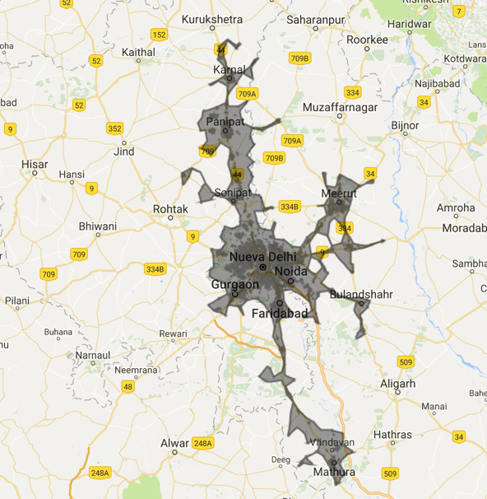
Delhi

Slide 47
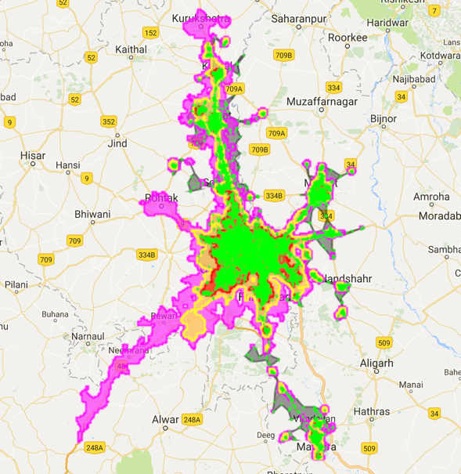
Delhi
NTL17.4 (20)
NTL33 (23)
NTL60 (14)
MIX (342)

Slide 48
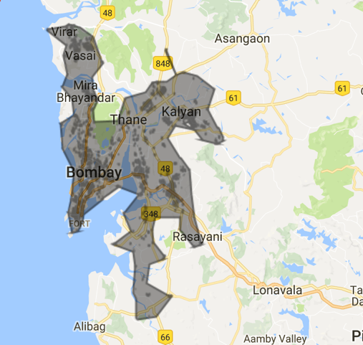
Mumbai

Slide 49
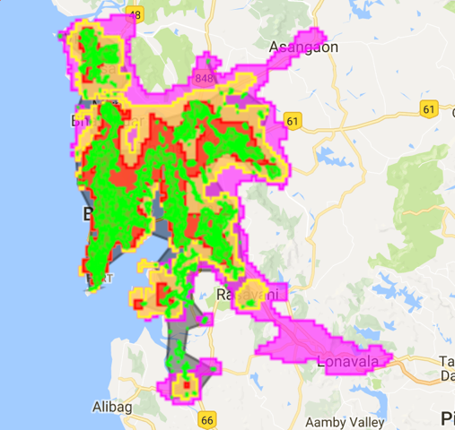
Mumbai
NTL17.4 (5)
NTL33 (5)
NTL60 (6)
MIX (70)

Slide 50
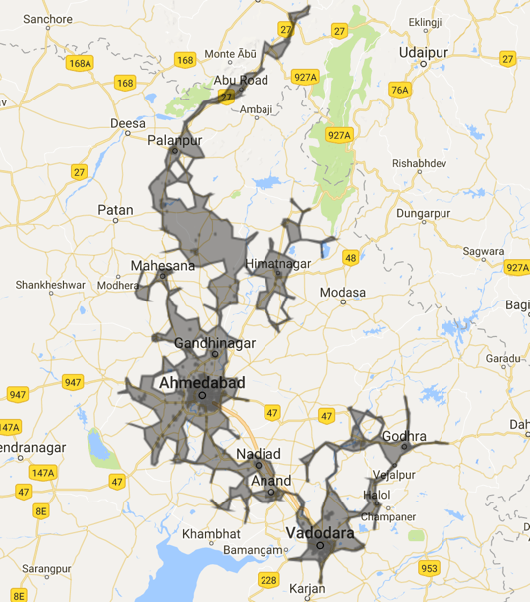
Ahmedabad

Slide 51
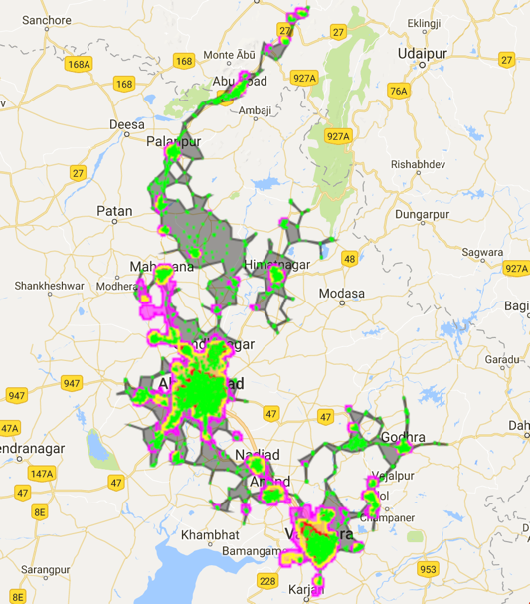
Ahmedabad
NTL17.4 (37)
NTL33 (30)
NTL60 (12)
MIX (445)

Slide 52
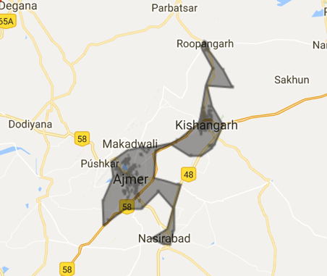
Ajmer

Slide 53
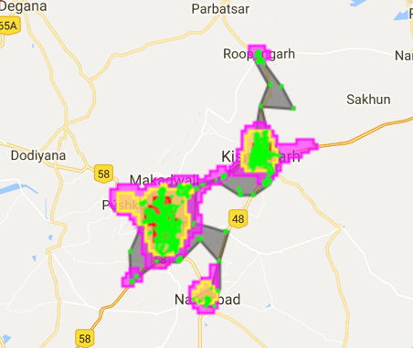
Ajmer
NTL17.4 (5)
NTL33 (3)
NTL60 (2)
MIX (33)

Slide 54
Markets within Markets

Slide 55
Markets within Markets

Slide 56
Markets within Markets

Slide 57
Markets within Markets

Slide 58
Markets within Markets

Slide 59
Distance to Other Markets within Super-Market

Slide 60
Super-Market Area Coverage

Slide 61
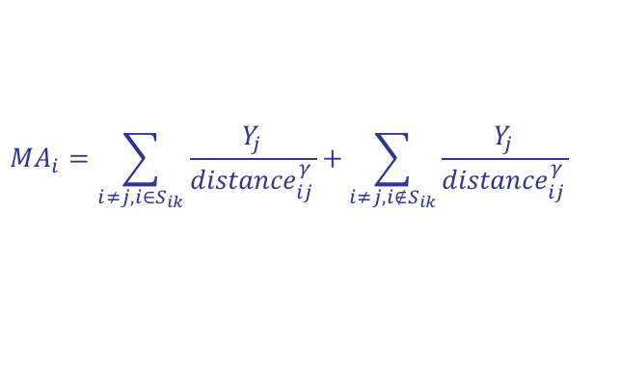
Market Access
Following Hornbeck & Donaldson 15, construct market access
Y_{j} is a measure of land area for market j
S_{ik} is the k={2,4,8}km super-market of market i
Distance is (crude) great-circle distance (waiting for digitized roads)
Set 𝛾=1.4 (Duranton et al 14, Allen Arkolakis 14)
Of interest is the share of market access contributed by markets that lie within the super-market
Captures potential benefits from local infrastructure investments
$$MA_{i}=\sum_{i≠j, i∈S_{ik}}{\frac{Y_{j}}{{distance}_{ij}^{γ}}+\sum_{i≠j, i∉S_{ik}}{\frac{Y_{j}}{{distance}_{ij}^{γ}}}}$$

Slide 62
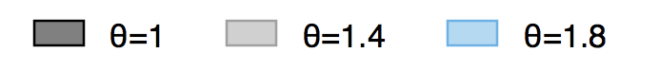
Market Access

Slide 63
Market Access

Slide 64
Market Access

Slide 65
Conclusion & Next Steps
Descriptive results suggest that detecting markets from daytime high-resolution images is feasible and informative
Next steps
Merge in population data from India Census
Examine market growth along extensive, intensive margins
Digitize India’s road network to measure changes in market access
Evaluate the impact of new, improved roads on market access
Scale algorithm to detect markets across the globe

Slide 66
Markets Definitions Across the Globe

Slide 69
Administrative Units, 2011 Census

Slide 70
Population WorldPop Data

